Slide 1
Renaissance
The “Rebirth”of Europe

Slide 2
Why Italy?
Urban Society - city-states became the focus of political, economic, and social life
Increasing Wealth - trade created new enjoyment of material things
Rebirth of interest in ancient cultures
High regard for human worth

Slide 3
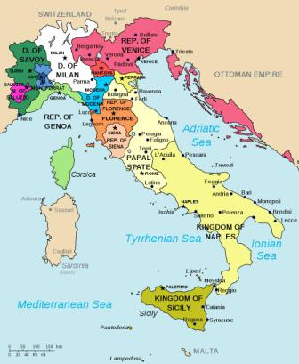
3 most powerful city-states
Venice
Milan
Florence
Important Rivals
Prospered from the growing trade with the Middle East

Slide 4
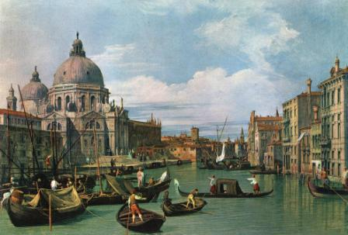
Venice
Northern Italy, link between Asia and Western Europe
Ran by a group of wealthy merchants.

Slide 5
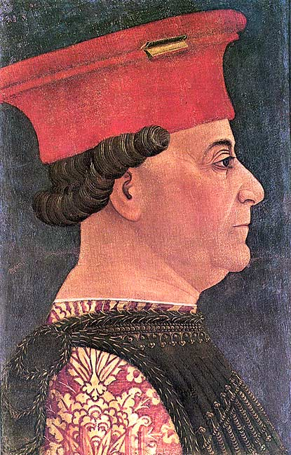
Milan
Crossroads of coastal cities and Alpine passes.
Francesco Sforza
Created a strong central gov’t and tax system

Slide 6
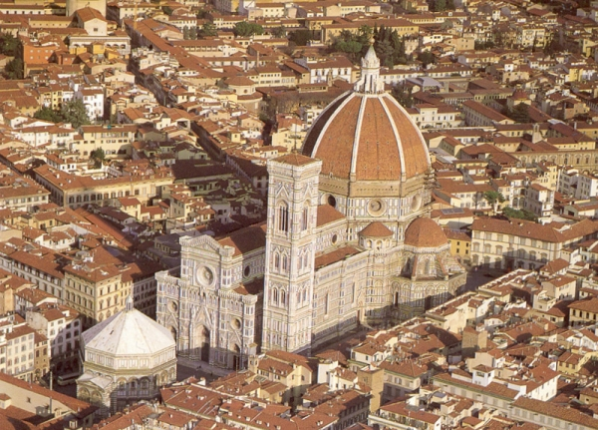
Florence
Tuscan Region
Medici Family

Slide 7
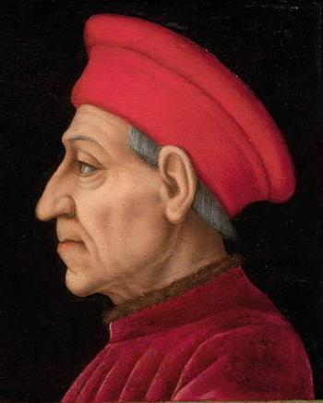
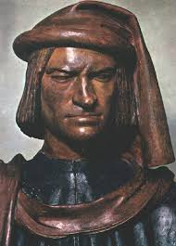
Medici Family
Wealthy manufacturing and banking family
Ruled Florence
Cosimo de’ Medici and Lorenzo de’ Medici
Both were important patrons of the arts during the 1400’s.
Helped Florence grow to a cultural center
Cosimo
Lorenzo

Slide 8
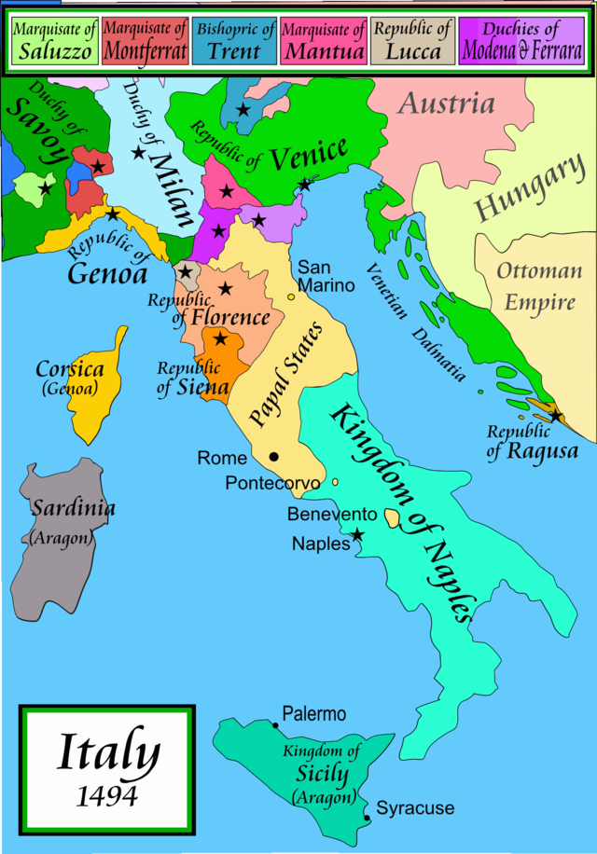
Italian Wars
Series of wars between 1494 – 1559
Powerful monarchies of Europe wanted to take advantage of the rivalry between the Italian city-states
France’s Charles VIII takes over Naples
Italian city-states look to Spain and HRE for help against France
Spain eventually sacks Rome due to lack of payment.

Slide 9
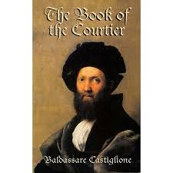
Italian Social Classes
Nobility
2%-3% of population
Help political positions and served as advisors to kings
Expected to follow certain values
The Book of the Courtier – by Castiglione
Nobles are born not made
Must have character, grace, and talent
Must have classical education and interest in arts
Must follow certain standards of conduct
The job of the noble was to serve his prince in an effective and honest way.

Slide 10
Italian Social Classes
Peasants
Rural
85% legally free
Patricians – banking and trade industry
Burghers – shopkeepers, artisans, guild members
Workers & Unemployed
Townspeople (Urban)

