Slide 1
The Protestant Reformation (1450-1565)

Slide 2
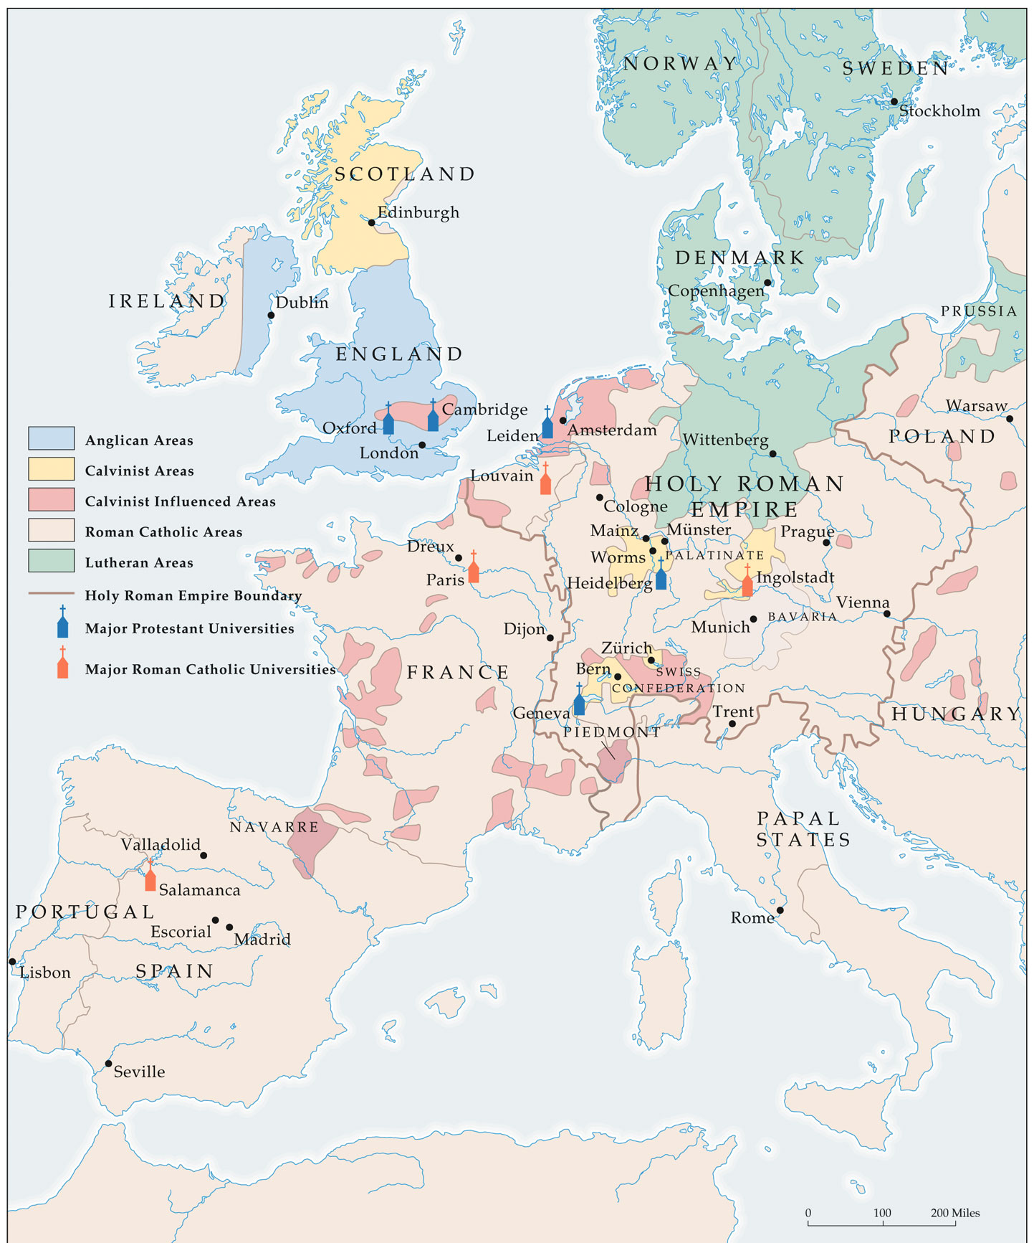
Reformation Europe (Late 16^{c})

Slide 3
Key Events Prior to the Reformation
1054 – Byzantine patriarch and Pope excommunicate each other – 1st schism
1073 – Pope Gregory VII claims pope’s authority is extended over all Christians
1095 – Pope Urban II call for Crusades on the Holy Land
1252 – Inquisition – Holy Office – deal with heretics
1378-1417 – The Great Schism
King Philip of France and allies elect new pope in Avignon
England and allies support pope in Rome

Slide 4
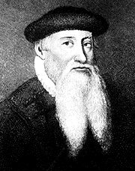
Influences: Printing Press
Invention of movable type in 1450’s by Johann Gutenberg
Manufacture of paper becomes easier and cheaper- more books
More criticism of the Church – reading of the Bible – challenge of doctrines

Slide 5
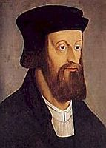
Influences: Cultural
Better educated, city people were critical of the Church
Renaissance monarchs challenged the power of the Church
Growing individualism

Slide 6
Christian Humanism
Developed in Northern Europe
Influenced by the new love of learning during the Renaissance
If people read classics and basic works of Christianity, they would become more pious

Slide 7
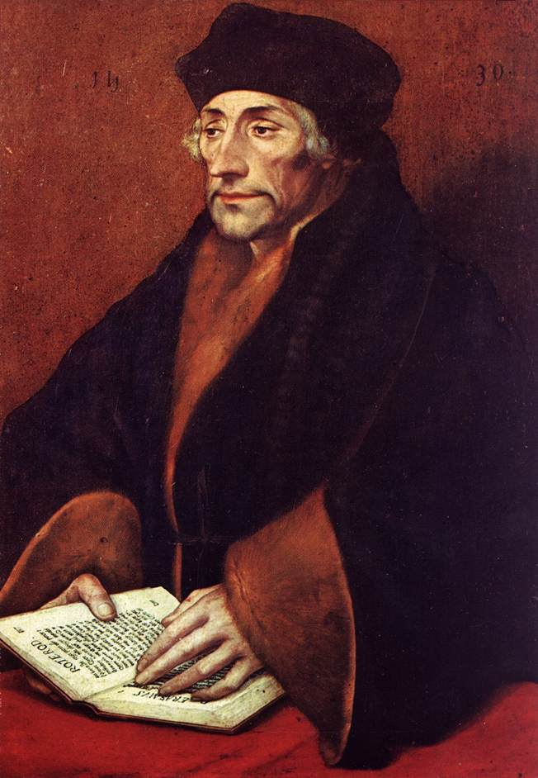
Desiderius Erasmus
Dutch Christian humanist
Live good lives on a daily basis NOT just provide beliefs for salvation
In Praise of Folly (1510) – criticized aspects of society
Call for a return to the simplicity of the early Church
Religion is inward NOT external
Wanted Reform NOT to break away

Slide 8
The Church’s Problems – Changing Viewpoint
Charges of greed
Worldly political power challenged
Weariness of dependence on the Church and the limitations it placed on the people
Growing human confidence vs. “original sin”
Catholic church becomes defensive in the face of criticism

Slide 9
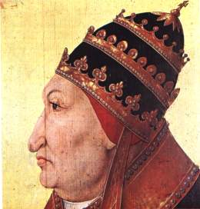
The Church’s Problems – Internal Issues
The corruption of the Renaissance Papacy
--Rodrigo Borgia
European population was increasingly anti-clerical
Absenteeism of church leaders
The controversy over the sale of indulgences

Slide 10
Religions in the World

Slide 12
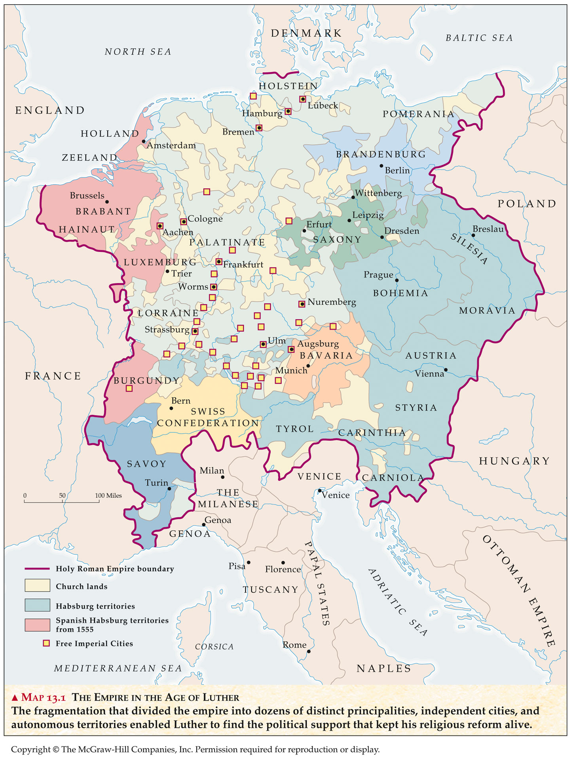
The Holy Roman Empire in the 16^{c}
“Why the Germanies?”

Slide 13
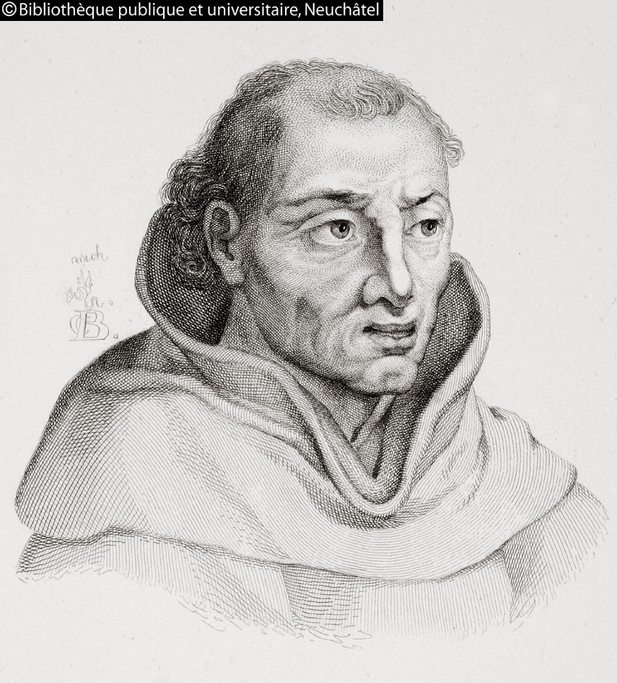
Germany (Martin Luther)
Luther troubled by the sale of indulgences
Dominican friar Tetzel was selling indulgences in Wittenberg in 1517
Luther posts his 95 Theses on the door of the castle church in Wittenberg on October 31, 1517

Slide 14
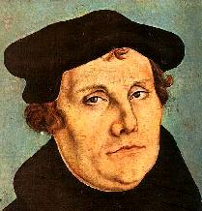
Germany (Luther)
Pope pays little attention to Luther at first
Luther attacks the Pope verbally and in writing
Luther is excommunicated (1521)
Luther is summoned to court

Slide 15
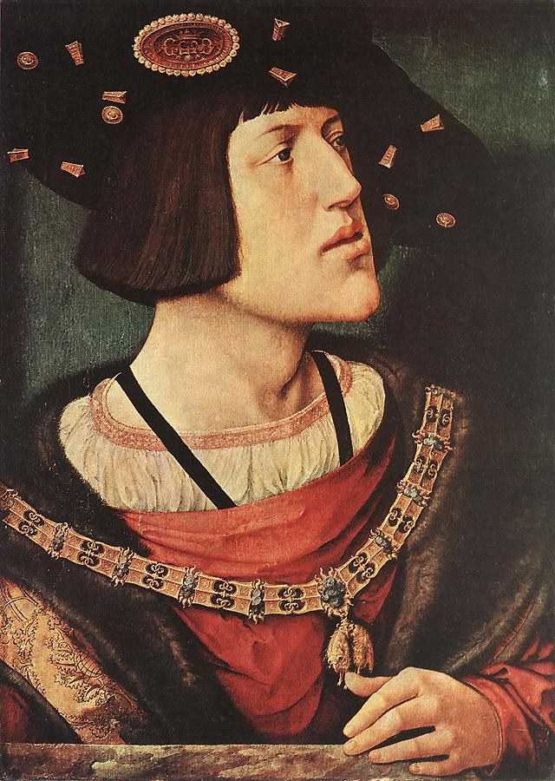
The Holy Roman Empire
New HRE, Charles V, is young and his power is threatened by the German Princes
Summons Luther to appear in Court
Edict of Worms – declares Luther an outlaw
Frederick of Saxony sends Luther into hiding

Slide 16
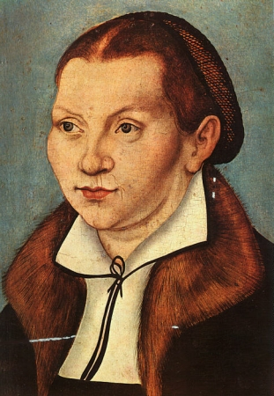
Political Support
German rulers who supported Luther took charge of Catholic Churches
1524 – Peasant Revolt – peasants looked for Luther’s support
Luther sided with the nobility
Luther believed State & Rulers were called by God to maintain peace to spread the gospel

Slide 17
Why Germany?
Part of the Holy Roman Empire – Emperor Charles V (Charles I of Spain) – Hapsburg Family
HRE was in consistent conflict with France and Ottoman Empire
HRE made up of hundreds of small territories
Local rulers supported Luther to assert their own authority
1555 – Peace of Augsburg – accepted division of Christianity in Germany – Local rulers could choose between Catholicism and Lutheranism

Slide 18
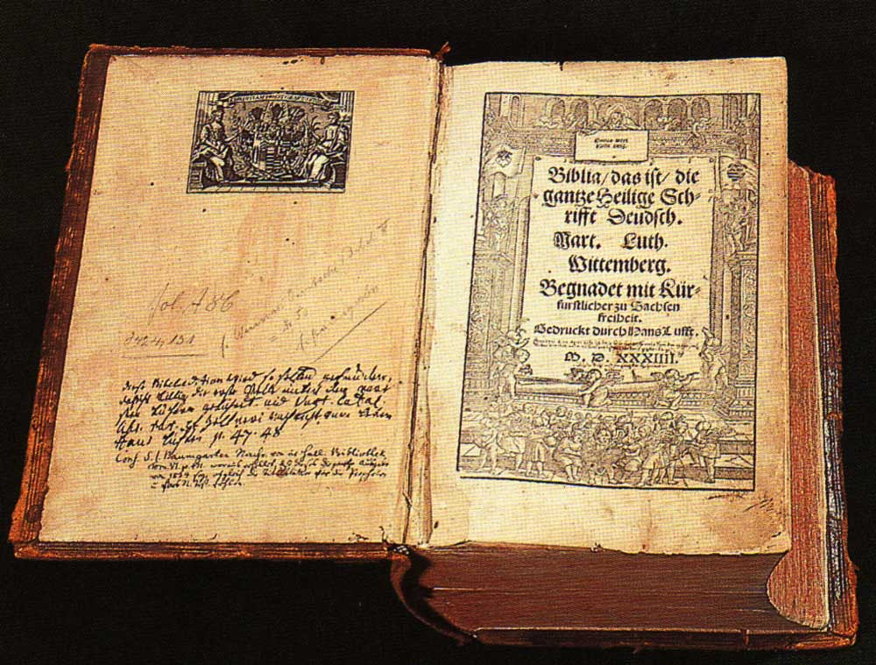
Luther’s Teachings
Luther’s sense of unworthiness and his fear of God
Salvation by Faith Alone
Bible is the only source of religious truth
--Luther’s German Translation of the New Testament
Humans are not saved on Good Works

Slide 19
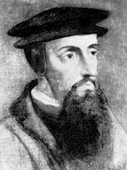
John Calvin
John Calvin’s leadership in Geneva from 1541-1564
Geneva became the model
Elements of a “theocracy”
Self-discipline and “Protestant Work Ethic”

Slide 20
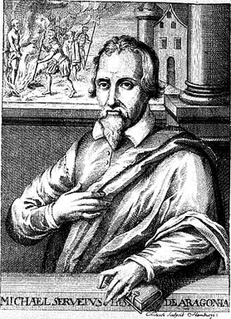
Calvin's Teachings
Predestination – god has determined who will be saved and man can do nothing to change this
Think of our Pilgrims
Simple lives worshipping god
No dancing, excessive drinking, gambling, no fancy clothing, nothing that can be considered sinful

Slide 21
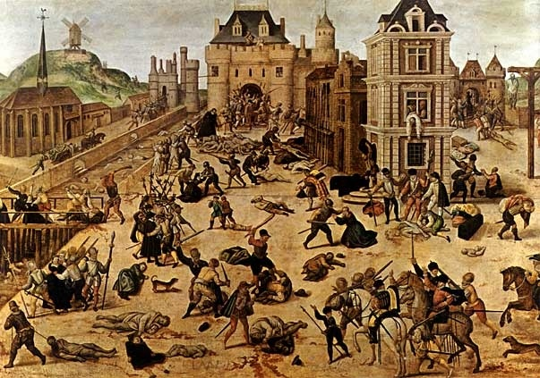
D. France
King Francis I was initially sympathetic to Luther as long as his ideas stayed in Germany
Protestantism made illegal in France in 1534

Slide 22
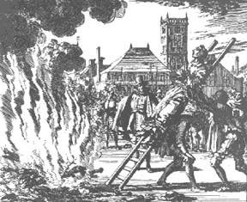
Anabaptists
Bitterly persecuted by both Catholics and other Protestants
Beliefs
Free will—all can be saved
Adult, “believer” baptism
Social and economic equality of all
Separation of Church and State

Slide 23
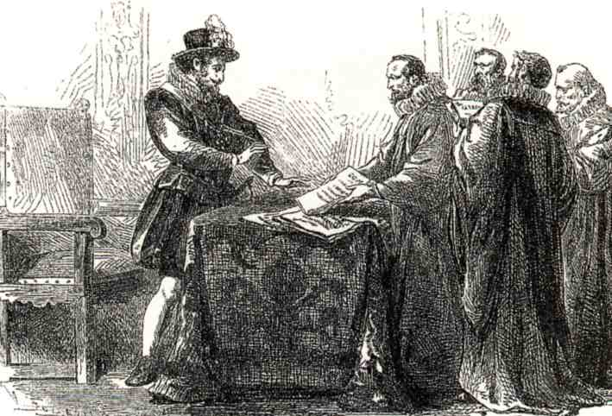
E. Other Parts of Western Europe
No Protestant inroads into Spain or Italy
Protestantism succeeded only where it was supported initially by the nobility
Most powerful European nations were Catholic

Slide 24
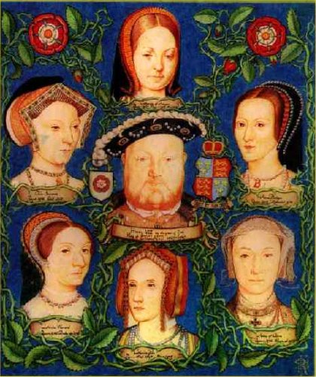
England
Henry VIII’s marriage to Catherine of Aragon
Henry seeks an annulment – the Pope refuses
Henry establishes the Church of England
Other wives of Henry VIII
--Anne Boleyn
--Jane Seymour
-- Anne of Cleves
-- Katherine Howard
-- Catherine Parr

Slide 25
Three Pillars of the Catholic Church
Papal Reform
Training for priests
Ended abuses
Council of Trent
Reaffirmed Church Teachings
Index – list of books banned by the Church
Inquisition – Church court that put heretics on trial
Jesuits
Ignatius Loyola
Society of Jesus – Absolute loyalty to the Pope

Slide 26
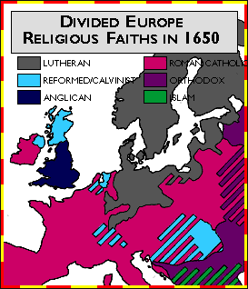
VI. Results of the Reformation
Germany was weakened – fighting between catholics and protestants
Christian Church was split in the West
100 Years of Religious Warfare
Growing doubt and religious skepticism

Slide 27
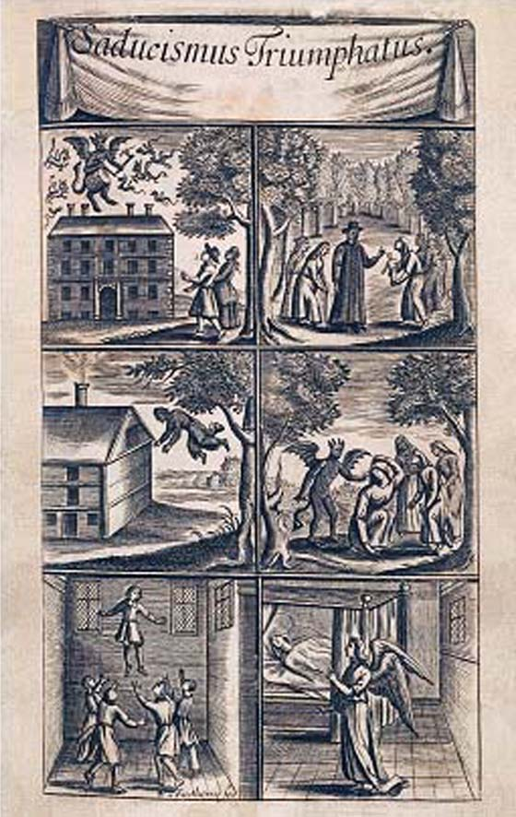
VI. Results of Reformation (cont)
Calvinism boosted the commercial revolution
Witch craze swept Europe in the 1600’s
--Between 1561-1670, about 12,000 people in Europe were executed as witches
Possible reasons for this witchcraft craze – traditional framework for dealing with misfortunes is gone

Slide 28
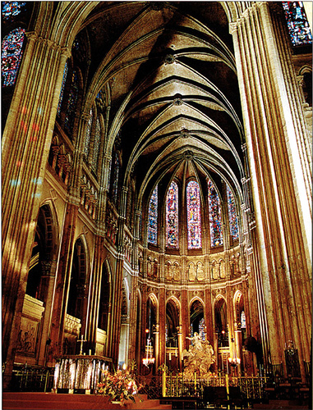
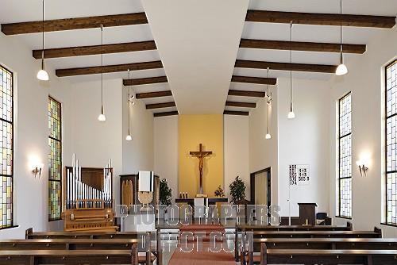
Catholic and Protestant Church
Type: | JPG

