Slide 1
Manifest Destiny

Slide 2
Trends in Antebellum America: 1810-1860
New intellectual and religious movements.
Social reforms.
Beginnings of the Industrial Revolution in America.
Re-emergence of a second party system and more political democratization.
Increase in federal power → Marshall Ct. decisions.
Increase in American nationalism.
Further westward expansion.

Slide 3
“Manifest Destiny”
First coined by newspaper editor, John O’Sullivan in 1845.
".... the right of our manifest destiny to over spread and to possess the whole of the continent which Providence has given us for the development of the great experiment of liberty and federaltive development of self-government entrusted to us. It is right such as that of the tree to the space of air and the earth suitable for the full expansion of its principle and destiny of growth."
A myth of the West as a land of romance and adventure emerged.

Slide 4
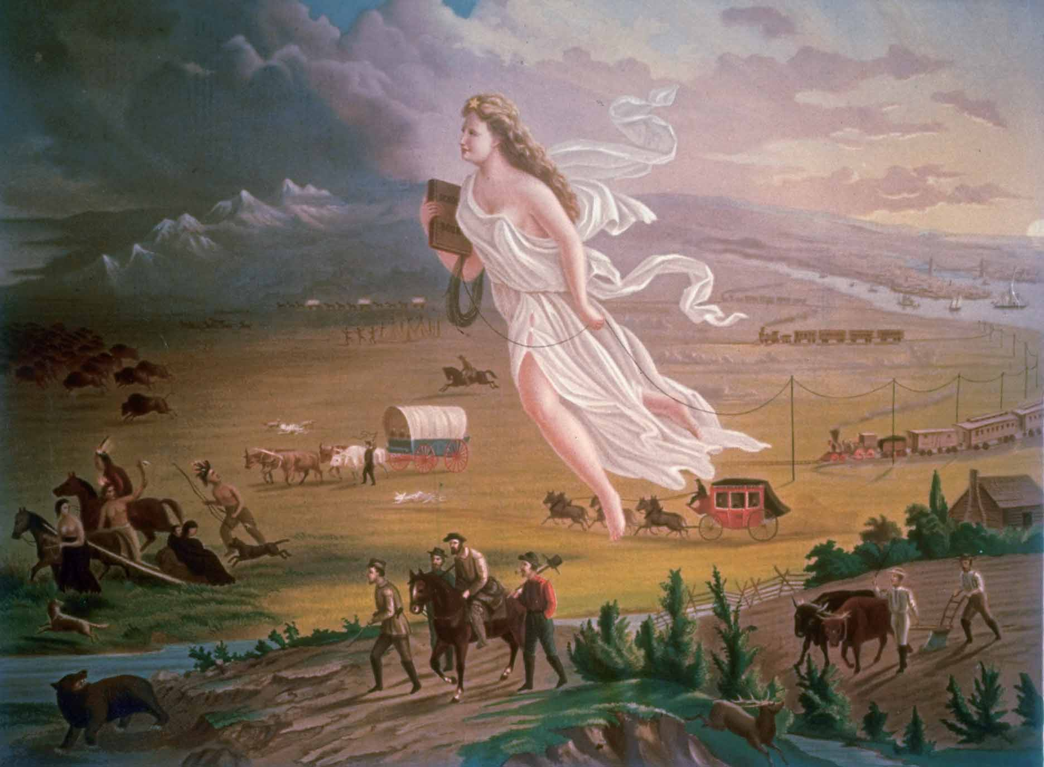
“American Progress” by John Gast, 1872

Slide 5
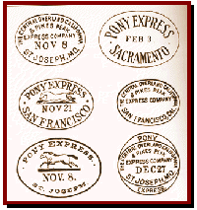
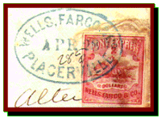
The Pony Express
Between April, 1860 and Nov., 1861.
Delivered news and mail between St. Louis, MO and San Francisco, CA.
Took 10 days.
Replaced by the completion of the trans-continental telegraph line.

Slide 6
Aroostook “War,” 1839
The only war ever declared by a state.
Between the Canadian region of New Brunswick and the state of Maine.
Cause: The expulsion of Canadian lumberjacks in the disputed area of Aroostook by Maine officials.
Congress called up 50,000 men and voted for $10,000,000 to pay for the “war.”
General Winfield Scott arranged a truce, and a border commission was convened to resolve the issue.

Slide 7
Maine Boundary Settlement, 1842

Slide 8
Texas Independence
1836-1845

Slide 9
Texas Declaration of Independence

Slide 10
Key Figures in Texas Independence, 1836
Sam Houston (1793-1863)
Steven Austin (1793-1836)

Slide 11
The Republic of Texas

Slide 12
Remember the Alamo!

Slide 13
Davey Crockett’s Last Stand

Slide 14
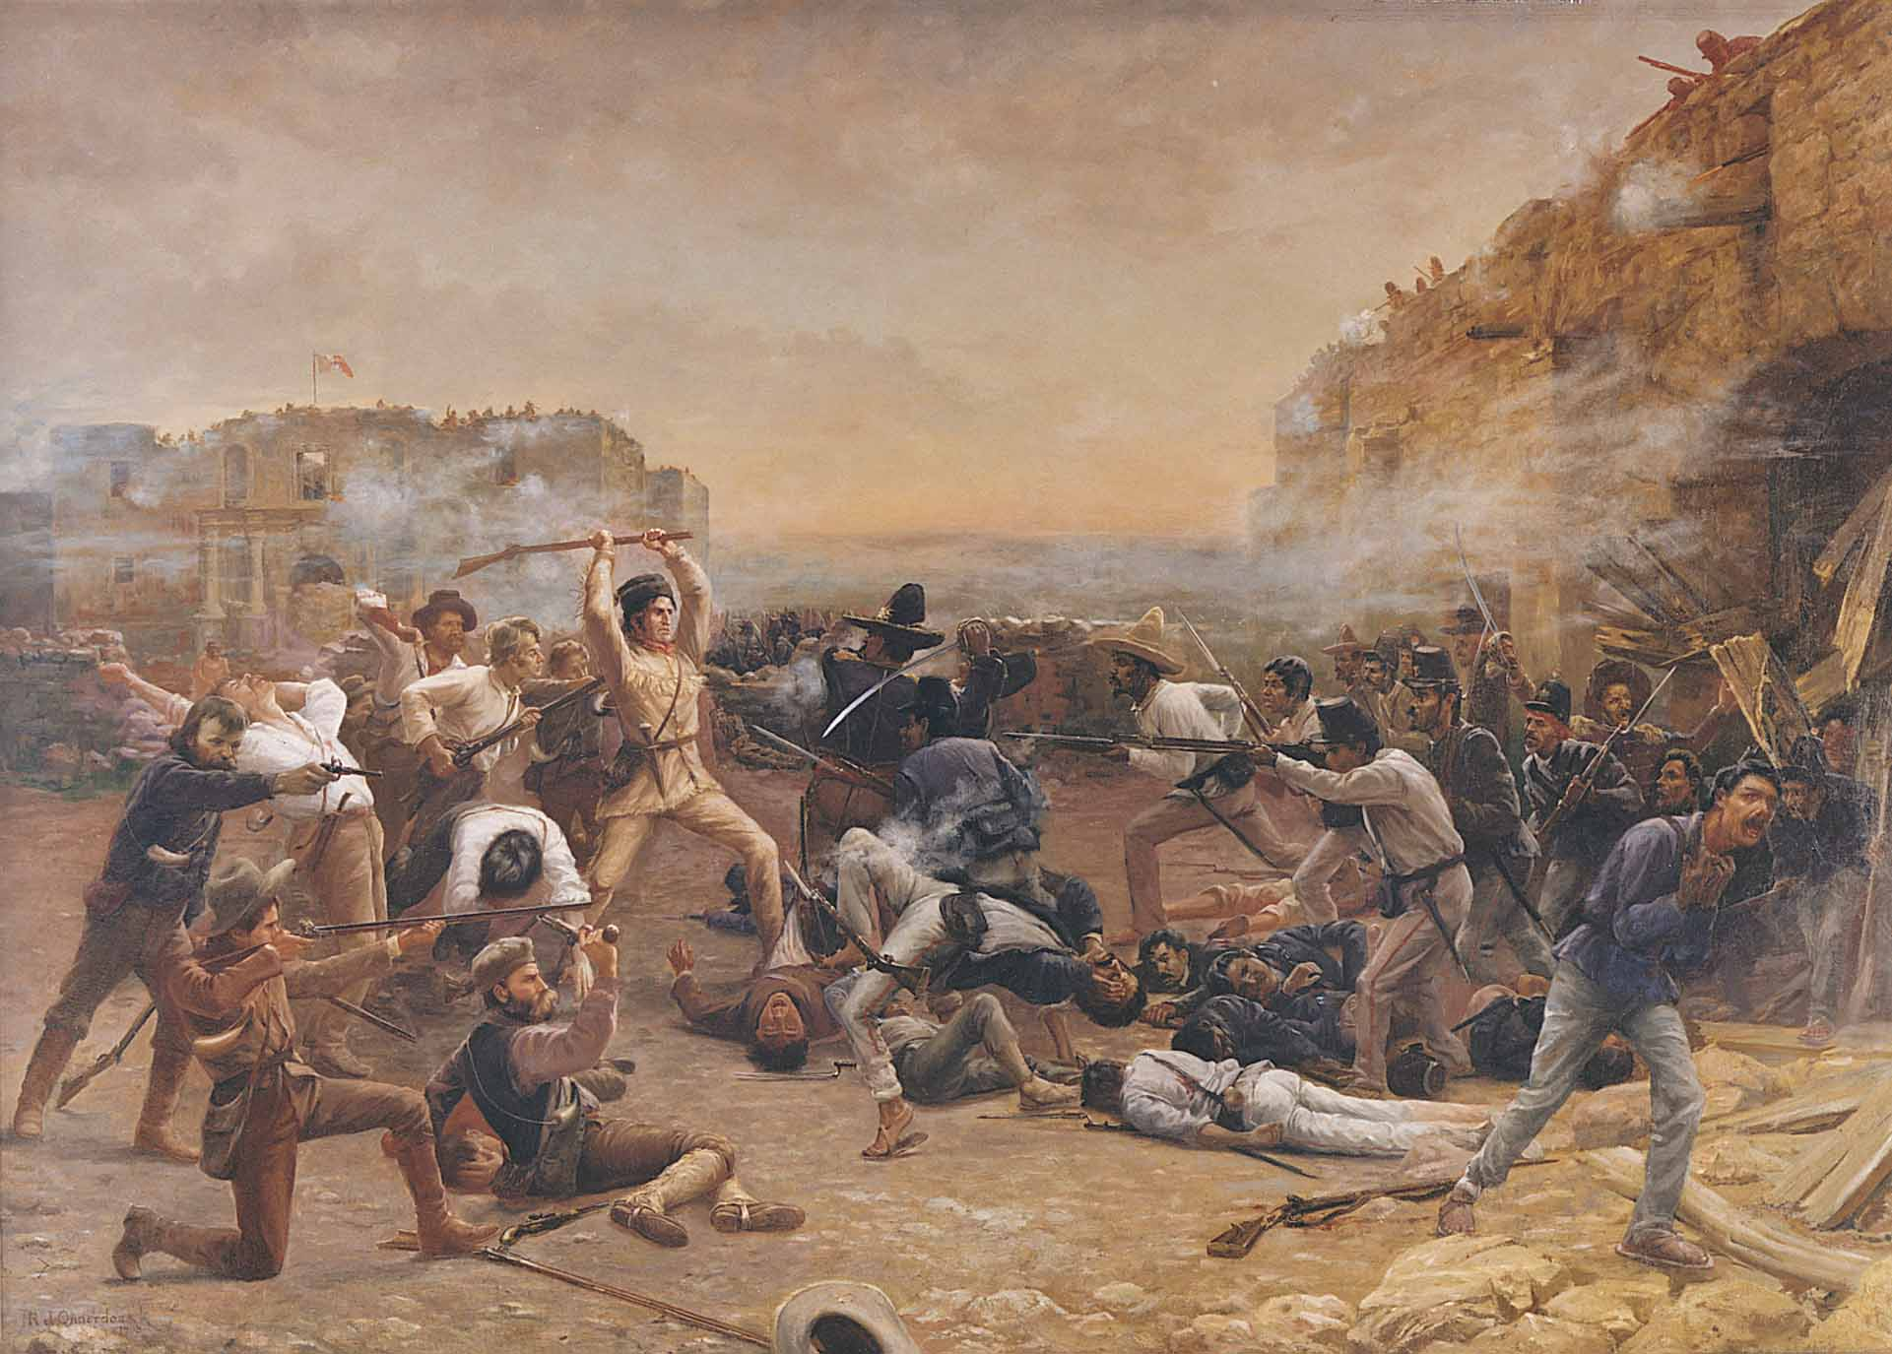
The Battle of the Alamo

Slide 15
Overland Immigration to the West
Between 1840 and 1860, more than 250,000 people made the trek westward.

Slide 16
The Oregon Trail – Albert Bierstadt, 1869

Slide 17
Trails Westward

Slide 18
The Doomed Donner Party
April, 1846 – April, 1847

Slide 19
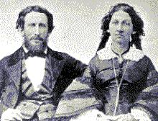
The Doomed Donner Party
CANNIBALISM ! !
Margaret Patrick John Breen Breen Breen
Of the 83 members of the Donner Party, only 45 survived to get to California!
James Reed & Wife

Slide 20
The Oregon Dispute: 54’ 40º or Fight!
By the mid-1840s, “Oregon Fever” was spurred on by the promise of free land.
The joint British-U. S. occupation ended in 1846.

Slide 21
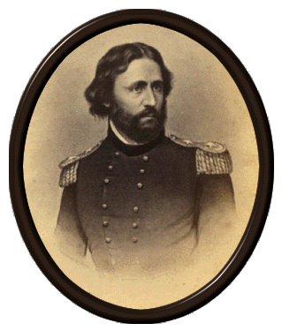
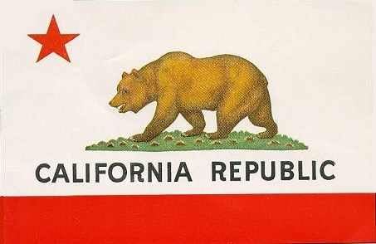
The Bear Flag Republic
The Revolt → June 14, 1845
John C. Frémont

Slide 22
The Mexican War
1846-1848

Slide 23
The Slidell Mission: Nov., 1845
Mexican recognition of the Rio Grande River as the TX-US border.
US would forgive American citizens’ claims against the Mexican govt.
US would purchase the New Mexico area for $5,000,000.
US would California at any price.
John Slidell

Slide 24
Wilmot Proviso, 1846
Provided, territory from that, as an express and fundamental condition to the acquisition of any the Republic of Mexico by the United States, by virtue of any treaty which may be negotiated between them, and to the use by the Executive of the moneys herein appropriated, neither slavery nor involuntary servitude shall ever exist in any part of said territory, except for crime, whereof the party shall first be duly convicted.
Congr. David Wilmot (D-PA)

Slide 25
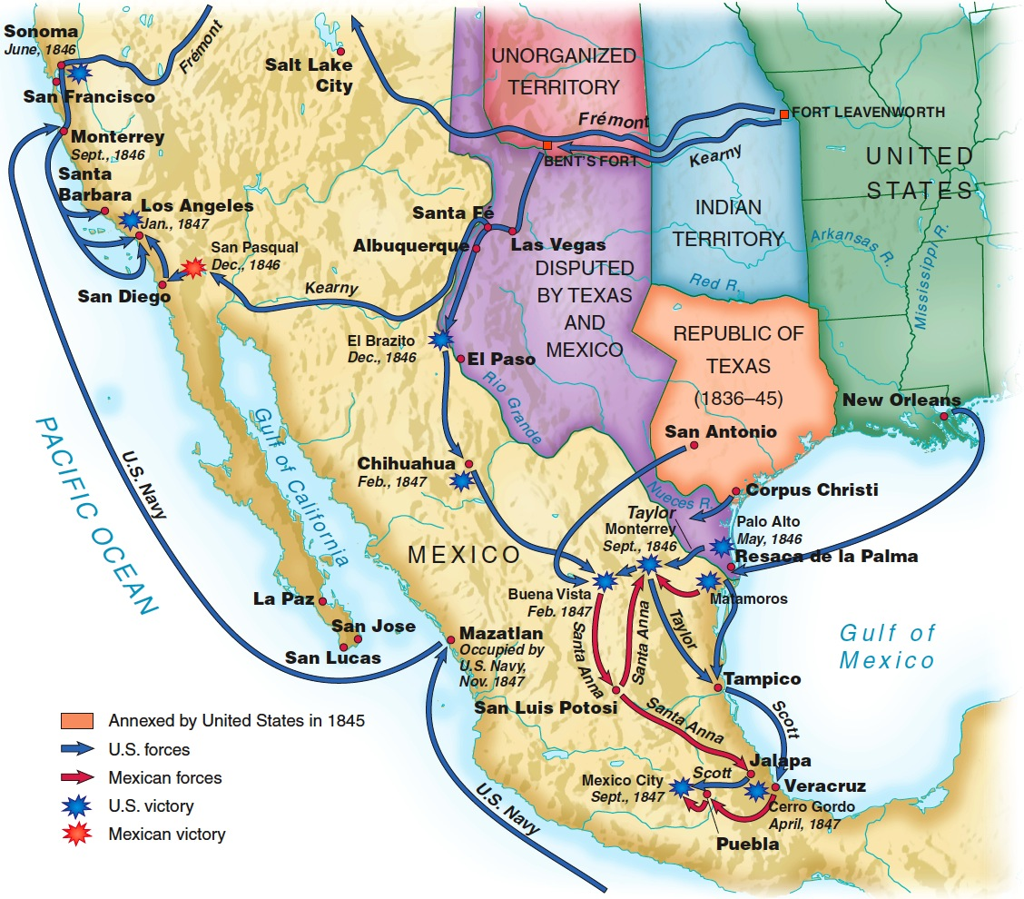
The Mexican War (1846-1848)

Slide 26
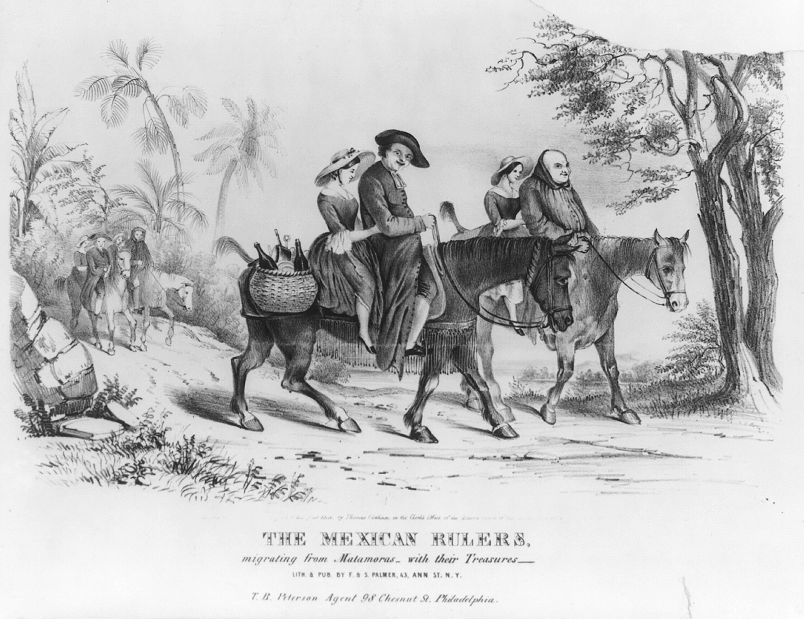
Anti-Catholic Feelings

Slide 27
General Zachary Taylor at Palo Alto
“Old Rough and Ready”

Slide 28
The Bombardment of Vera Cruz

Slide 29
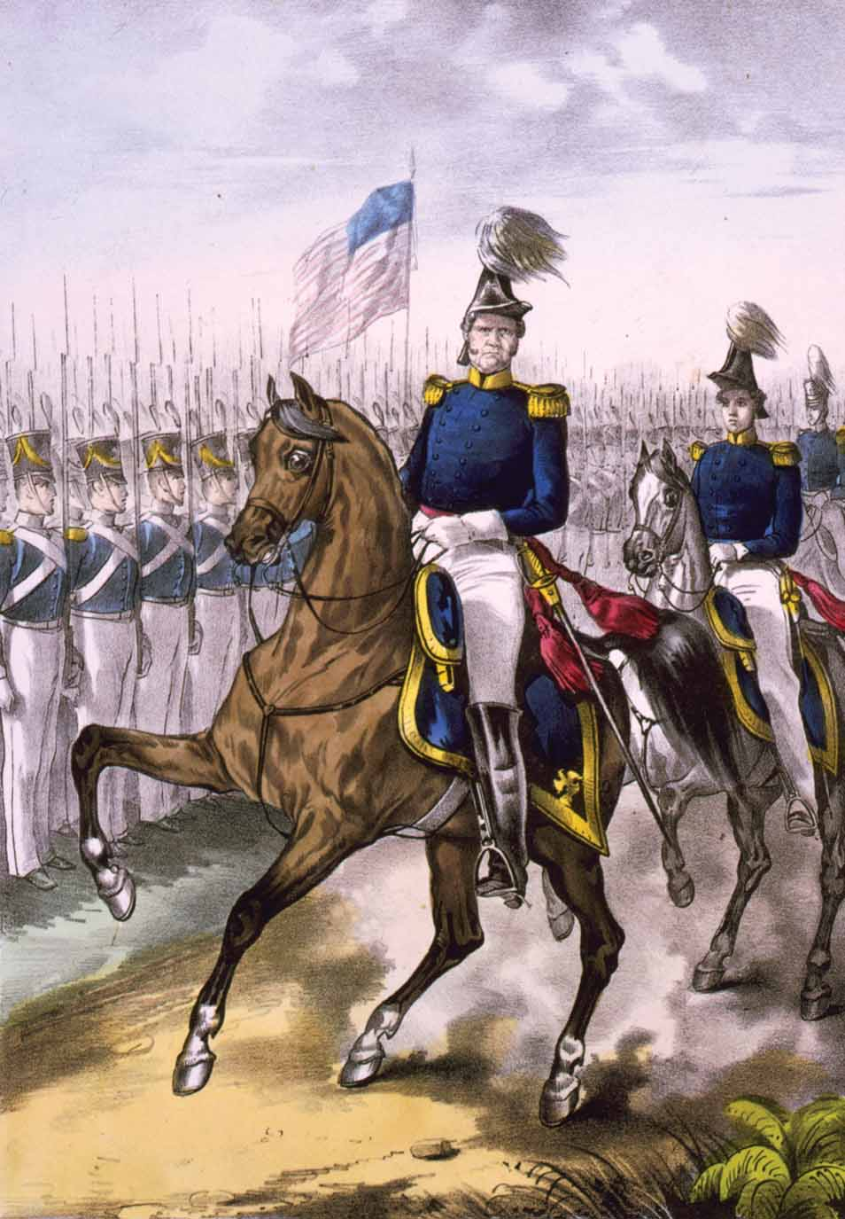
Battle of Buena Vista (1847)
General Winfield Scott

Slide 30
General Scott Enters Mexico City
“Old Fuss and Feathers”

Slide 31
Treaty of Guadalupe-Hidalgo, 1848
Nicholas Trist, American Negotiator

Slide 32
Treaty of Guadalupe-Hidalgo, 1848
The Treaty was basically forced on Mexico!
Mexico gave up claims to Texas above the Rio Grande River.
Mexico gave the U. S. California and New Mexico.
U. S. gave Mexico $15,000,000 and agreed to pay the claims of American citizens against Mexico

Slide 33
Results of the Mexican War?
The 17-month war cost $100,000,000 and 13,000+ American lives (mostly of disease).
New territories were brought into the Union which forced the explosive issue of SLAVERY to the center of national politics. * Brought in 1 million sq. mi. of land (incl. TX)
These new territories would upset the balance of power between North and South.
Created two popular Whig generals who ran for President.
Manifest Destiny partially realized.

Slide 34
Unresolved Issues and Opportunities

Slide 35
Free Soil Party
Free Soil! Free Speech! Free Labor! Free Men!
“Barnburners” – discontented northern Democrats.
Anti-slave members of the Liberty and Whig Parties.
Opposition to the extension of slavery in the new territories!
WHY?

Slide 36
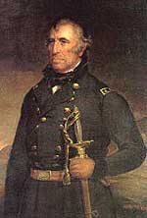
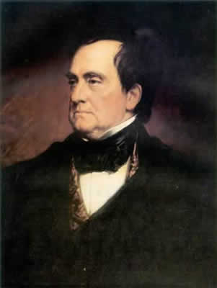
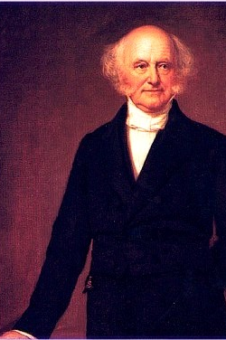
The 1848 Presidential Election Results
√

Slide 37
The Mexican Cession

Slide 38
GOLD! At Sutter’s Mill, 1848
John A. Sutter

Slide 39
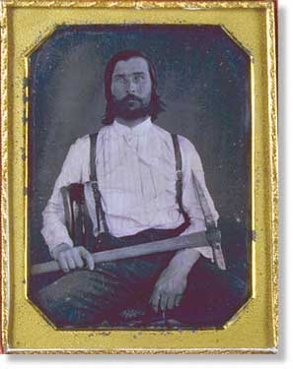
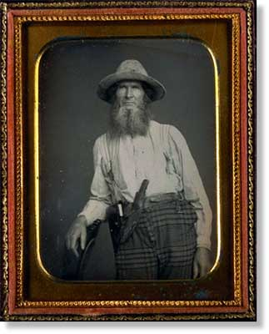
California Gold Rush, 1849
49er’s

Slide 40
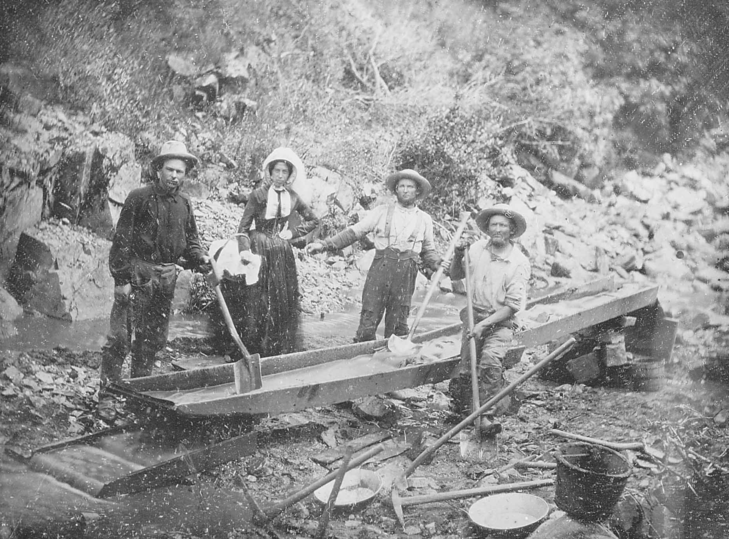
Digging for Gold in California

Slide 41
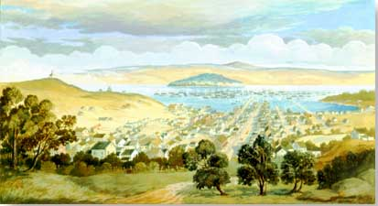
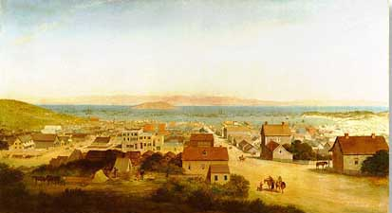
Two Views of San Francisco, Early 1850s
By 1860, almost 300,000 people had traveled the Oregon & California Trails to the Pacific coast.

Slide 42
Territorial Growth to 1853

Slide 43
Westward the Course of Empire Emmanuel Leutze, 1860

Slide 44
Expansionist Young America in the 1850s
America’s Attempted Raids into Latin America

