Slide 1
Industrial Revolution

Slide 2
What is the Industrial Revolution?
Industry- trade or manufacture in general
Revolution- a sudden, complete, or marked change in something
Industrial Revolution- a complete and total change in the United States industry and how it worked

Slide 3
Where did it begin?
It began in Britain
It transformed the way people lived
Landscapes changed from the rural, agricultural towns to industrial, urban centers
Industries became mechanized, especially affecting textiles
Britain’s large deposits of coal and iron ore made it a perfect starting point

Slide 4
British Advancements
James Hargreaves- He was a British carpenter and weaver
In 1764 he created the Spinning “Jenny” (short for engine)
A hand-powered multiple spinning machine
One person could produce multiple spools of thread at once

Slide 5
British Advancements
Samuel Crompton- He was a British inventor
In 1779 he created the Spinning Mule
He took the Spinning “Jenny” and combined it with water power
The spinner had great control over the weaving process, many different types of yarn could be produced

Slide 6
British Advancements
Edmund Cartwright- He was a British inventor
In 1785 he created the first power loom
It was a mechanized process for weaving cloth
It had a steam engine that ran on alcohol

Slide 7
British Advancements
Thomas Savery- British military engineer and inventor
In 1698 he created the first, crude steam engine
Thomas Newcomen- British blacksmith
Newcomen’s engine used atmospheric pressure running in a vacuum design
James Watt- Scottish inventor and mechanical engineer
He created the model for all modern steam engines

Slide 8
Industrialization Begins in America
It began in 1790 with British immigrant Samuel Slater
He was a genius and worked in a British industrial mill
He memorized the plans for an industrial mill because it was illegal to take the plans out of Britain
He built the first industrialized mill in Pawtucket, RI

Slide 9
Industrialization for the South
Eli Whitney- An American inventor from New England
He created the cotton gin in 1793
Cotton Gin- A machine that automated the separation of cottonseed from the short-staple cotton fiber
It allowed for about 50 lbs of raw cotton to be seperated as opposed to the hundreds of man hours it previously took
It skyrocketed the need for slaves to pick cotton in the South

Slide 10
Cotton Gin

Slide 11
Expansion of Industrialization
Factory System
Railroads
Mill Towns

Slide 12
Railroads: Westward Expansion
Americans expand further west
This was driven by:
The US desire to control more land and resources
The development of the railroad

Slide 13
Railroads: The Two Companies
Two companies tried to build the railroad first
Union Pacific Railroad
Central-Pacific Railroad Co.
Both companies used the influx of Chinese immigrants as cheap labor

Slide 14
Railroads: Transcontinental Railroad
1830: First steam locomotive
1849: Gold in California really caused a rush to move west
The US government decided to subsidize the building of a railroad that connected coast to coast

Slide 15
Railroads: The Tracks
Both companies would begin building tracks that would meet at one place then continue as one
The companies competed against each other and continued separately until they were forced to combine at Salt Lake City, Utah

Slide 16
Railroads: “The West”
This time period gives us the idea of the “Wild West”
Towns that were relatively lawless and order was kept with guns
Gambling, drinking, and morally loose living were common
Criminals occupied many of these towns

Slide 17
Railroads: Native Americans
Tensions continued to mount between the US and the Native Americans
Conflicts over the expanding US caused deaths on both sides
The most famous: Custer’s Last Stand
June 25, 1876 a group of American soldiers were slaughtered by Native Americans under Sitting Bull
US used tactics such as biological warfare

Slide 18
Factory System
Prior to the Industrial Revolution most products, especially textiles, were produced in the home
People used hand tools and simple machines to fabricate goods in their homes or small shops
The large, water and steam powered machines needed to be used in larger warehouses
The production of goods was centralized into one location that was able to mass produce products
Workers used large machines and worked in shifts to produce goods

Slide 19
Factory System: Production in Factories
Factories were dangerous
Poor venting caused heat and harmful gases to build up
Equipment was dangerous to work on causing many accidents
Hours were long and pay was low
Women and children were favored workers because they would be paid less and they were smaller
Smaller hands allowed for them to make adjustments on the machine to keep it running
This often caused accidents such as hands getting chopped off

Slide 20
Mill Towns
With the growth of factories and demand a larger labor force was needed
As a way to provide cheap, close lodging and also to control their workers factory owners built mill towns
These were small towns that had housing and stores for the workers that were close to the factory
They were run by the company so the goods and rent was paid to the company
Some even used company tokens to pay workers instead of cash that could only be used at company stores

Slide 21
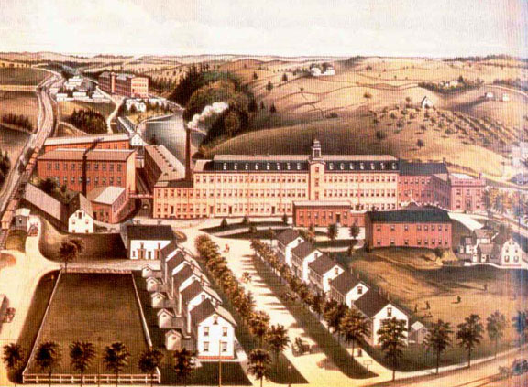

Slide 22
Cities
The industrialization of the US creates larger cities
Cities become crowded and sanitation was poor
Due to crowding and tenement style housing crime and fires were a problem
Famous Great Fire of Chicago: 300 people died, 100,000 were left without homes, and $200 million dollars of damage

Slide 23
American Inventions
Ford- Assembly line
One of the most influential innovations of the American industrial revolution
It mechanized the way products moved in the factory
A product would be placed on a conveyor belt and move along
Workers had stations and would complete the same task hundreds of times a day
It opened the job market because you did not need to be highly educated to complete the tasks

Slide 24
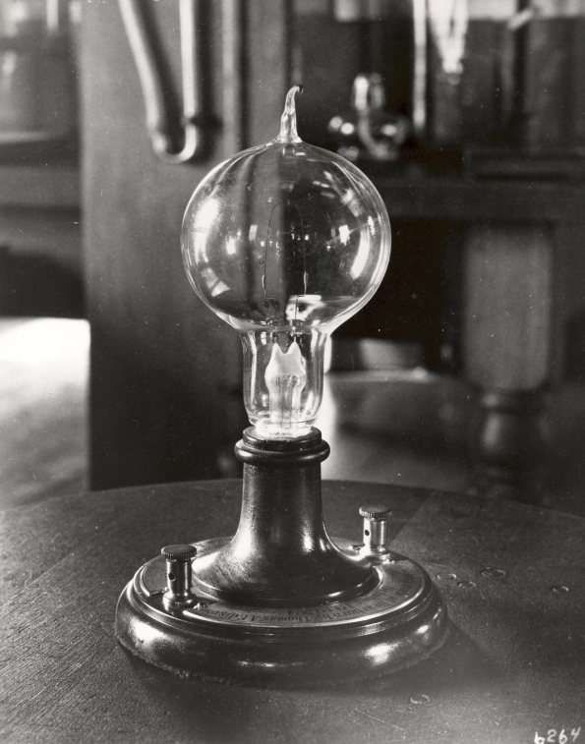
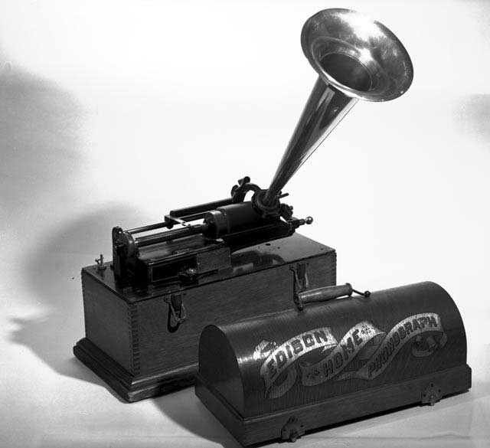
American Inventions
Thomas Edison- American inventor and businessman
He patented 1,093 different items
Created the light bulb
Created the phonograph- a device to record and play sounds and music
The first recording he created was “Mary had a little lamb”

Slide 25
Capitalism
An economic system in which the means of production and distribution is privately or corporately owned and development is proportionate to the accumulation and reinvestment of profits gained in a free market

Slide 26
Ideals of Capitalism
Capital- wealth in the form of money or property
Market Economy- an economic system where supply and demand determine what is offered in the marketplace
Laissez Faire (Free Market Economy)- the government does not interfere with business at all

Slide 27
Influential Inventions
Alexander Graham Bell- Scottish scientist, inventor, and engineer
Created the first telephone

Slide 28
Robber Barons vs. Captains of Industry

Slide 29
What is a Robber Baron?
Robber Baron- a ruthlessly powerful US capitalist or industrialist of the late 19th century considered to have become wealthy by exploiting natural resources, corrupting legislators, or unethical means

Slide 30
What is a Captain of Industry?
Captain of Industry- an ingenious or industrious leader who transformed the US economy with his business skills

Slide 31
Henry Ford
Born June 30, 1863
Chief engineer at Edison’s Illuminating Co.
Created the Quadricycle- first self-propelled vehicle with a gasoline engine

Slide 32
Ford’s Industry
Ford revolutionized the automobile industry in two ways:
Using his assembly line production he was able to make vehicles faster and cheaper
His Model T was a easy to operate, maintain, and handle on rough roads making it extremely popular
He created it in 1908 and by 1918 half of all cars in the US were Model T’s

Slide 33
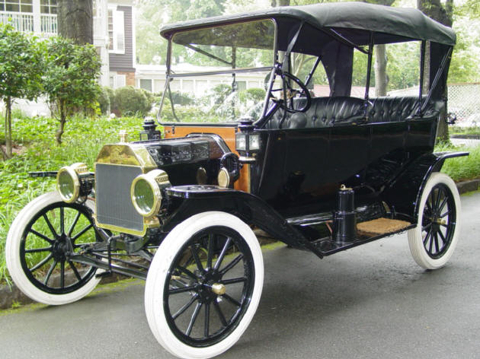

Slide 34
Andrew Carnegie
Born in 1835 in Dunfermline, Scotland
He was the definition of a “rags to riches” story
He worked as a factory boy, a telegraph operator, and in the railroad business

Slide 35
Carnegie’s Industry
He was the steel manufacturer of the US
His company, Carnegie Steel, produced more metal than all of Britain by 1900
He used a new style of refining iron to create stronger steel instead of the brittle iron
He believed in controlling an industry horizontally- Ex: he owned the iron mines, the refining process, the steel production and distribution, and pieces of the railroad industry

Slide 36
John D. Rockefeller
Born on June 8, 1839 in Richford, NY
He was one of the original “pitch men” working as a traveling salesman
He was also a book keeper and self-employed merchant

Slide 37
Rockefeller’s Industry
He created the company Standard Oil
He also believed in horizontal control- he owned oil refining, barrel making for holding oil, owned shipping for oil, owned the tanks for holding the oil, and owned the plants that held the oil waste

Slide 38
Andrew W. Mellon
Born March 24, 1855 in Southampton, NY
He worked for his father at his banking house
He served as Secretary of the Treasury under President Harding
He reduced the national debt from $24,000,000,000 to $17,604,000,000 as treasurer

Slide 39
Mellon’s Industry
He built up his father’s bank by lending out money to Pittsburg based companies
He also had his hand in some business like oil and steel but banking was where he made his money

Slide 40
Cornelius Vanderbilt
Born on May 27, 1794 in Staten Island, NY
He came from a poor family with his father working as a deckhand his whole life
He owned a small passenger steam boat as his first job

Slide 41
Vanderbilt’s Industry
He began purchasing steam boats and by the mid 1840’s had more than 100 boats
He used cut throat rates and questionable business techniques to control the steam boat business
He moved into railroads and provided the same great service in rail transportation
5 years in the railroad business he had made $25 million dollars

Slide 42
John “J.P.” Morgan
Born April 17, 1837 in Hartford, CT
He is hailed as a master of finance and still considered one of America’s best business bankers
He worked for his father before starting his own company

Slide 43
Morgan’s Industry
After working for his father he started his own banking company, which would become the leading financial firm in the country
He had some money in steel as well as banks
His bank is still in existence today as one of the largest financial institutions

Slide 44
The Debate
Monopoly- exclusive control of a commodity or service in a particular market, or a control that makes possible the manipulation of prices
It is this complete control and setting of prices along with the ruthless and questionable business tactics that makes these men Robber Barons

Slide 45
Philanthropy
Greek- “love of mankind” and is a concern for human welfare and advancement
Carnegie-“The man who dies rich dies disgraced”
These men gave tremendous amounts of money to charities and universities:
Carnegie-Mellon University
Rockefeller Center
Vanderbilt University
Carnegie gave away $350 million
Rockefeller gave $75 million to the University of Chicago and $235 million to other charities

