Slide 1
Imperialism
“The Sun Never Sets on the British Empire”

Slide 2
Industrial Revolution transformed the West in two ways: 1. Science 2. Technology
Definition:
Imperialism – domination by one country of the political, economic, or cultural life of another country or region.

Slide 3
Causes
1. Economic Interests
Natural Resources – rubber, petroleum, manganese, palm oil
New Markets - to sell factory goods
2. Political & Military
Bases – to resupply steam powered ships and naval vessels with coal
Nationalism – claimed that colonies were needed for national security

Slide 4
Causes
Humanitarianism
Missionaries, doctors and colonial officials were sent to spread the blessings of Western Civilization (medicine, law, & Christianity)
Social Darwinism
“Survival of the Fittest”
European races were superior to all races. Conquest and Destruction of weaker races will improve the human species.

Slide 5
Western Advantages
Strong Economies
Well Organized Govt’s
Powerful Armies
Superior Technology (Maxim Gun)
Medical Knowledge (ie. Quinine)
Resistance?
Strengthened some invaded societies
Domestically
Tools for the rich
Immoral -

Slide 6
Types of Rule
Colonies
Direct Rule – officials sent to rule (French)
Indirect Rule – local leaders ruled (British)
Protectorates
Local rulers expected to follow the advice of European Advisors (cheaper)
Sphere of Influence
Outside power claims exclusive investment and trading privileges

Slide 7
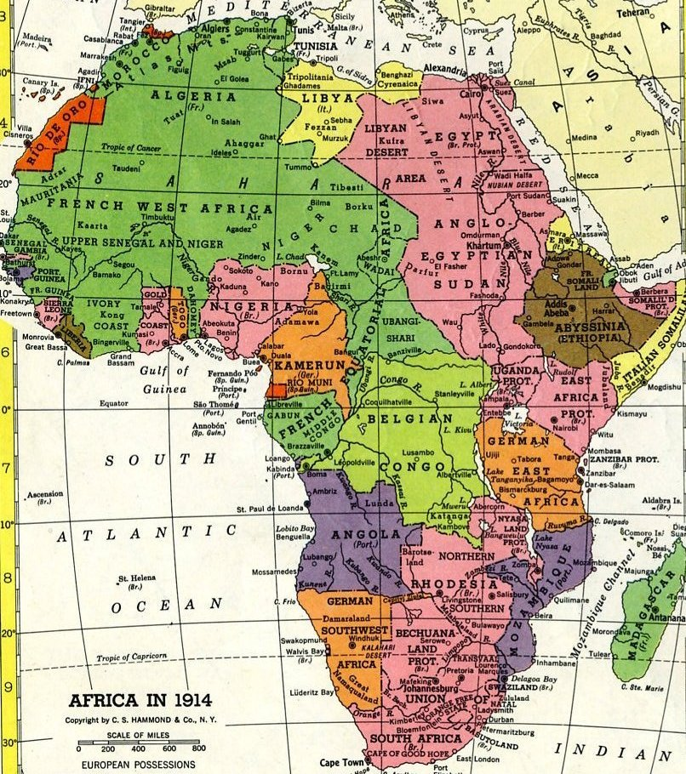
Africa 1914

Slide 8
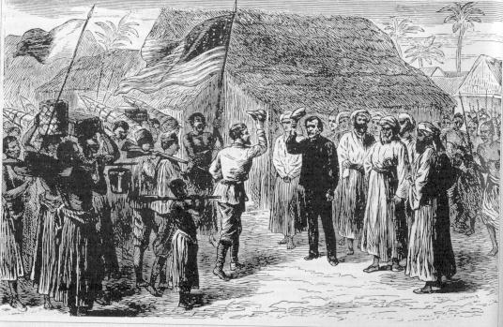
Early Contact in Africa
Explorers – Goal was to reach the interior of Africa using the Niger, Nile, and Congo Rivers.
Missionaries – spread Christianity, build schools and medical clinics
Dr. Livingstone – most famous, created a detailed travel of Africa
“Dr. Livingstone, I presume?

Slide 9
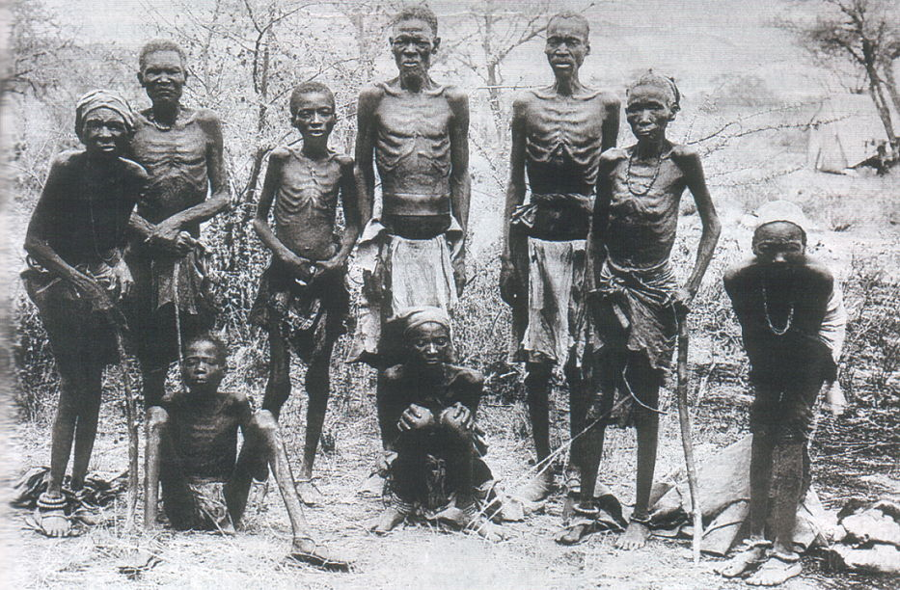
European Scramble
King Leopold of Belgium -1860’s attains control of the Congo. (Ivory & Rubber)
Eventually had to turn the Congo over to the government due to brutalization of workers.

Slide 10
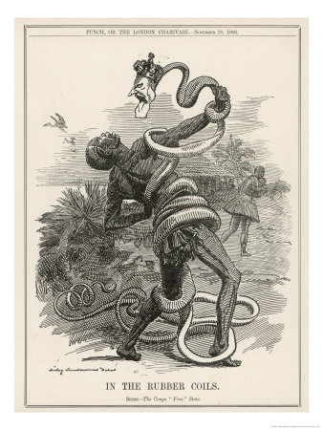
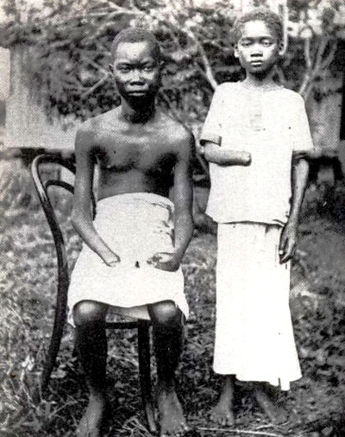

Slide 11
Berlin Conference
Meeting of European nation in 1884.
Recognized Belgium’s claim to the Congo, but free trade on the Congo and Niger River.
European country could not claim power without setting up a government office.
In 20 years, Europe carved new borders and territories with complete disregard of original citizens.

Slide 12
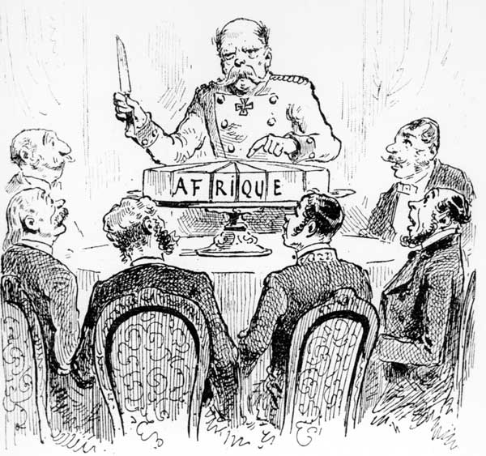
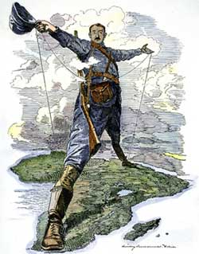
Political Cartoons

Slide 13
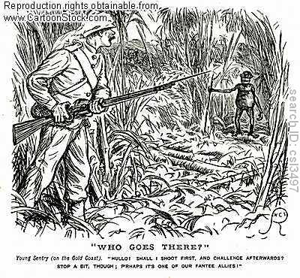
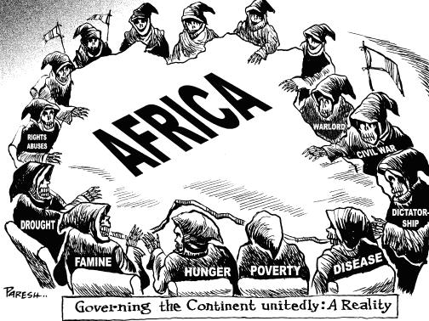

Slide 14
Resistance
Nehanda – female ruler of the Shona Tribe, gathered an army and fought the British. Captured and Executed.
Menelik II – Ruler who modernized Ethiopia
Built modern roads and bridges, schools, and imported weapons.
Defeated an invading Italian army in 1896 to remain independent.
Elite Class – African upper class emerged, Western educated, who supported independence.

Slide 15
Muslim World
3 Major Muslim Empires
Mughals (India)
Ottomans (Middle East)
Safavids (Iran)
All in decline, central governments lose control

Slide 16
Ottoman Empire 1798-1923

Slide 17
Ottoman Empire
Pashas – local rulers
Revolts throughout empire
Eastern Europe
North Africa
Egypt claims independence
Westernization was one of the key reason for uprising

Slide 18
Young Turks
1908 – Overthrow of the sultan
Goal was to reform in order to save the empire
Armenian Genocide
Muslim Turks distrusted Armenian Christians
Aprox 1 million killed over 25 years
Still a highly sensitive topic today

Slide 19
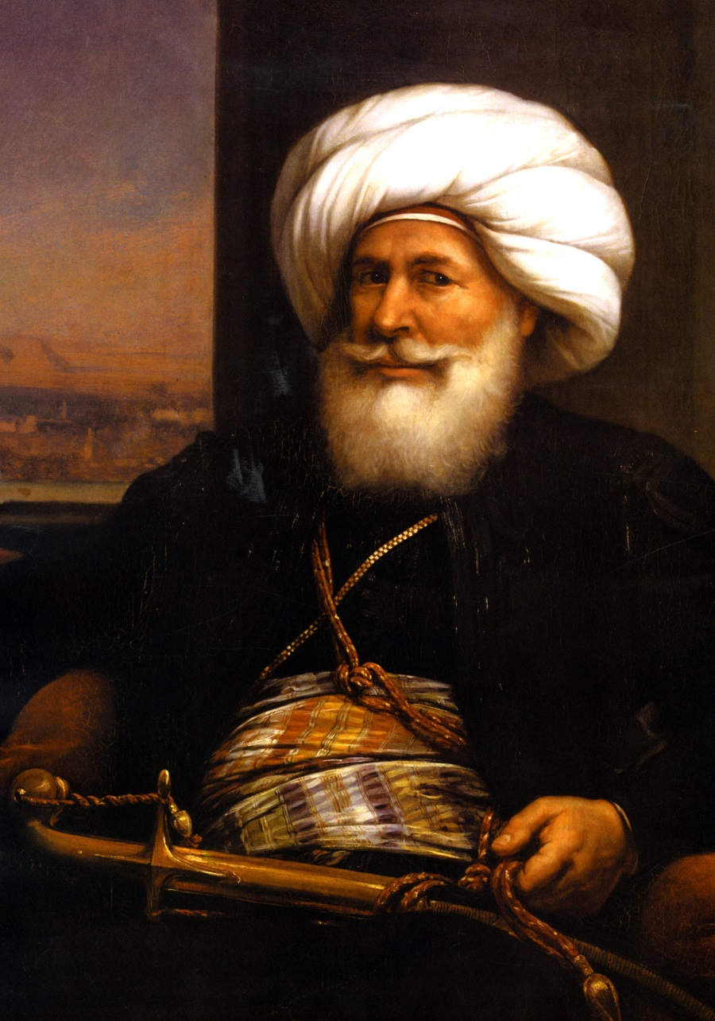
Egypt
Muhammad Ali
“Father of Modern Egypt”
Dynasty 1805-1914

Slide 20
Egypt
Introduce modern political and economic reform
Hired military experts to train military
Suez Canal (1869)
100 mile waterway connecting Med and Red Sea
Egypt ran out of money to finish project
Britain bought the shares to the Canal
Became lifeline to India
Egypt becomes a protectorate of England. Gov remains official of Ottoman Empire
http://www.youtube.com/watch?v=MlM1G3oaUZo

Slide 21
Iran
Sphere of Influence
Russian in the North
Britain in the South
Founding of oil in 1900’s
Iranian gov’t persuaded to allow special economic rights to foreign powers.

